Slide 1
Integrating Power BI with SQL Server 2016
Notes:
This module discusses the big picture of the integration that exists between the Power BI platform and SQL Server 2016. Students will learn about scenarios in which it makes sense to implement large-scale tabular databases using SQL Server Analysis Services (SSAS). The module also discusses the key concepts and techniques involved when designing Power BI Desktop projects that connect to on-premises tabular database running in SSAS. The module goes into detail to explain the requirements for passing the effective user name to in a hybrid environment to take advantage of the role-based security features of SSAS from within a Power BI solution. The second half of the module discusses the integration between the Power BI platform and custom reporting solutions that have been deployed on-premises using SQL Server Reporting Services (SSRS). Along the way, students will learn how to establish a connection between an on-premises SSRS instance and the Power BI service which makes it possible to pin tiles to a Power BI dashboard which link users to SSRS reports running on-premises.

Slide 2
Agenda
Integrating Power BI with SQL Server 2016
Implementing Tabular Databases with SSAS
Connecting Power BI to Analysis Services
Implementing Reporting Solutions with SSRS
Integrating Power BI and SQL Reporting Services

Slide 3
Integrating Power BI with SQL Server 2016
Which Parts of SQL Server 2016 Integrate with Power BI?
SQL Server Database Engine
SQL Server Analysis Services (SSAS)
SQL Server Reporting Services (SSRS)
Power BI offers special features with SQL Server 2016
Power BI can connect to standard SQL Server databases
Power BI can connect to tabular & multidimensional databases
DirectQuery mode can be used to create live connections
EffectiveUserName can be passed to SSAS databases
SSRS can establish a connection to a Power BI workspace
SSRS Reports can be added to Power BI Dashboard

Slide 4
Agenda
Integrating Power BI with SQL Server 2016
Implementing Tabular Databases with SSAS
Connecting Power BI to Analysis Services
Implementing Reporting Solutions with SSRS
Integrating Power BI and SQL Reporting Services

Slide 5
Implementing Tabular Databases with SSAS
You can created tabular database for SSAS
Data modeling done with Visual Studio
Data modeling very similar to working with PBIDT
Unfortunately, no PBIDT Query features
Why would you do this?
Tabular databases can grow very large if required
Use Database table partitions
Use translations
Use role-based security

Slide 6
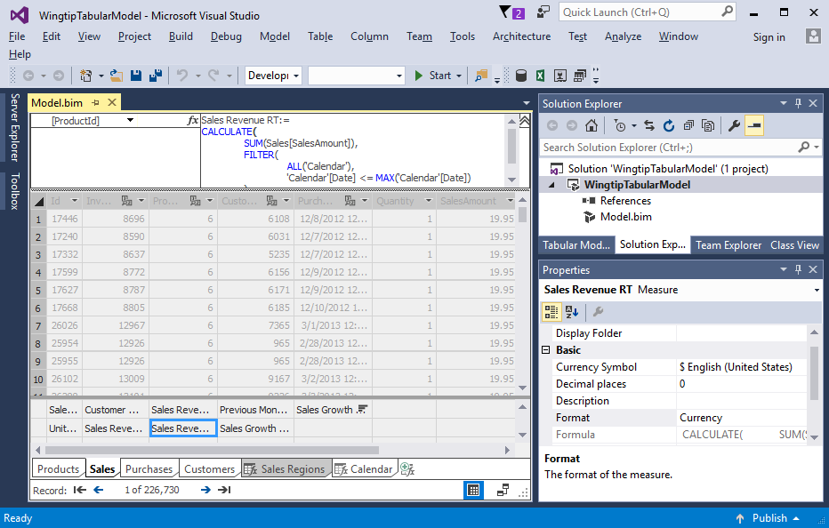
Visual Studio with the Tabular Model

Slide 7
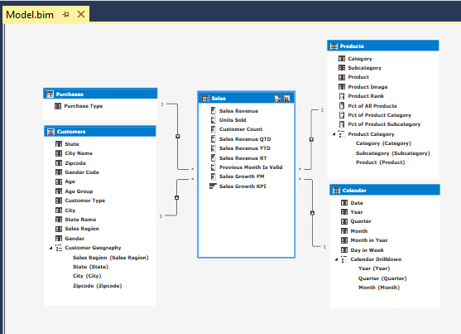
Creating a Data Model

Slide 8
Agenda
Integrating Power BI with SQL Server 2016
Implementing Tabular Databases with SSAS
Connecting Power BI to Analysis Services
Implementing Reporting Solutions with SSRS
Integrating Power BI and SQL Reporting Services

Slide 9
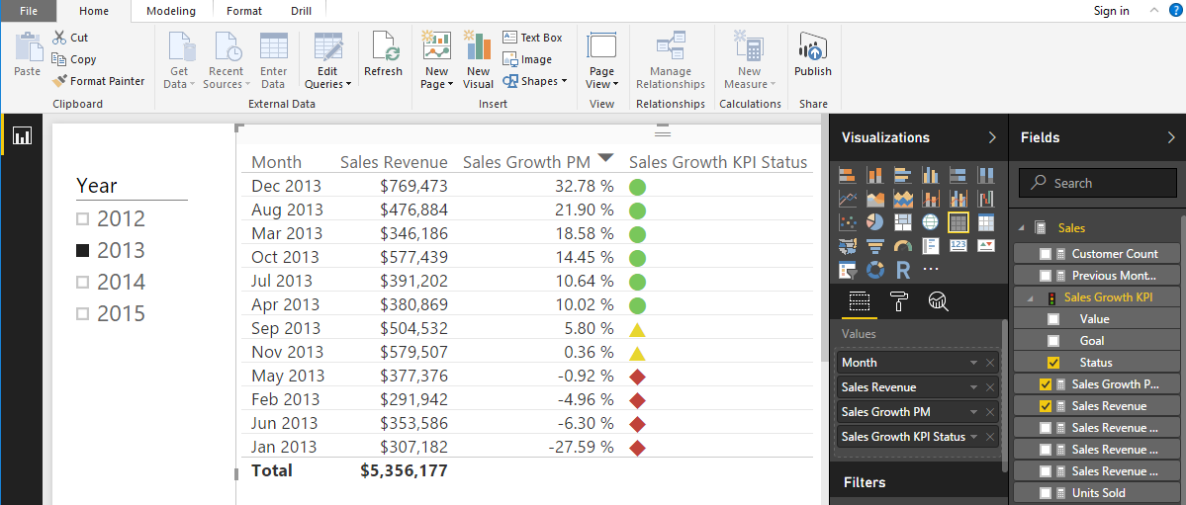
Connecting Power BI to Analysis Services
Power BI Desktop can connect to SSAS
Connection can be imported or live connect

Slide 10
Agenda
Integrating Power BI with SQL Server 2016
Implementing Tabular Databases with SSAS
Connecting Power BI to Analysis Services
Implementing Reporting Solutions with SSRS
Integrating Power BI and SQL Reporting Services

Slide 11
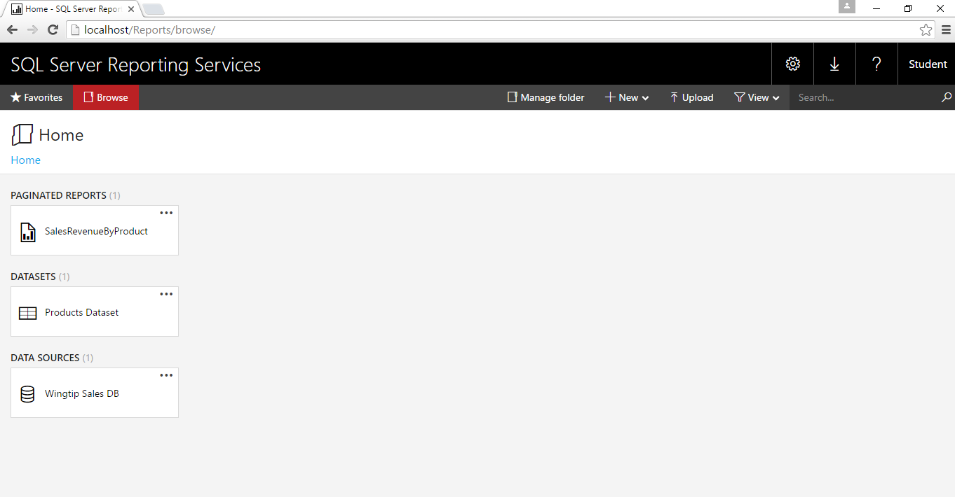
Implementing Reporting Solutions with SSRS
SSRS provided two different report designers
Report Builder 3.0 (classic SSRS report designer)
Mobile Reports Designer (Datazen Acquisition)

Slide 12
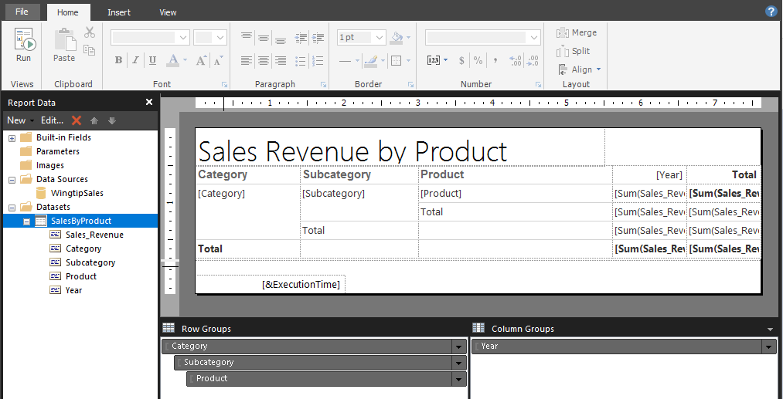
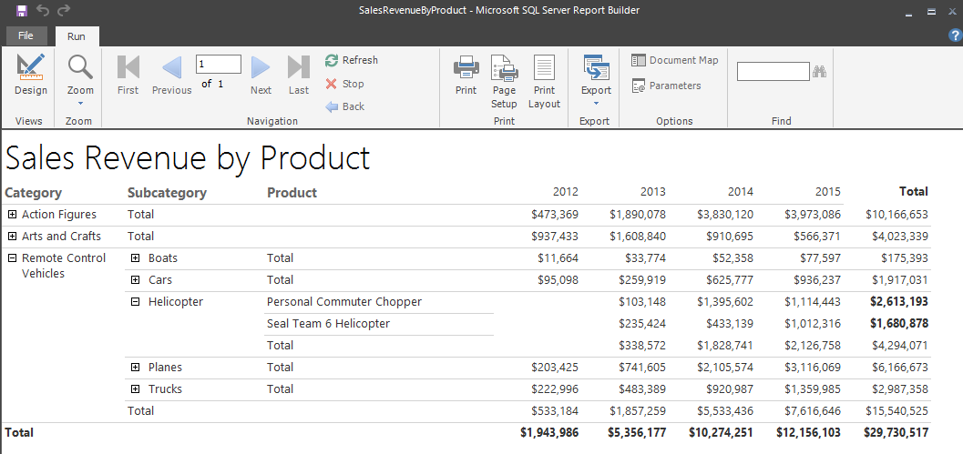
Report Builder 3.0

Slide 13
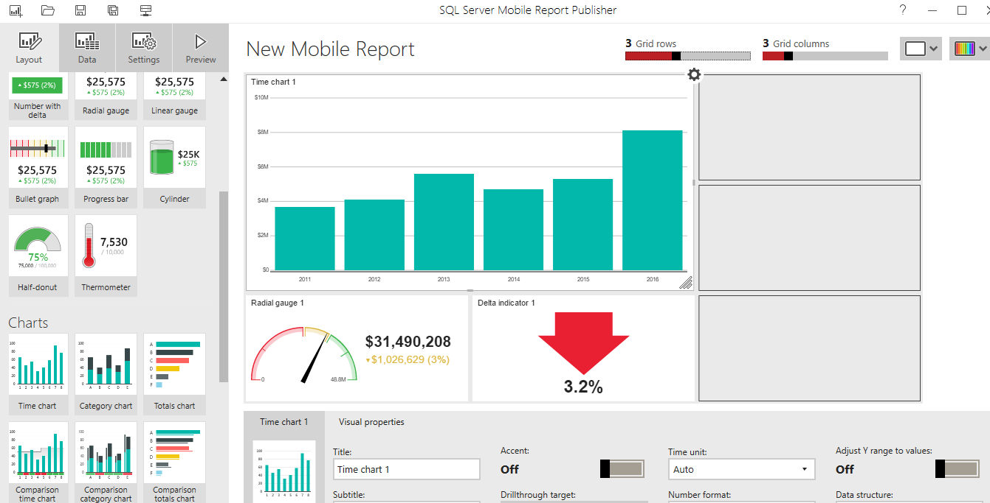
Mobile Reports Designer

Slide 14
Agenda
Integrating Power BI with SQL Server 2016
Implementing Tabular Databases with SSAS
Connecting Power BI to Analysis Services
Implementing Reporting Solutions with SSRS
Integrating Power BI and SQL Reporting Services

Slide 15
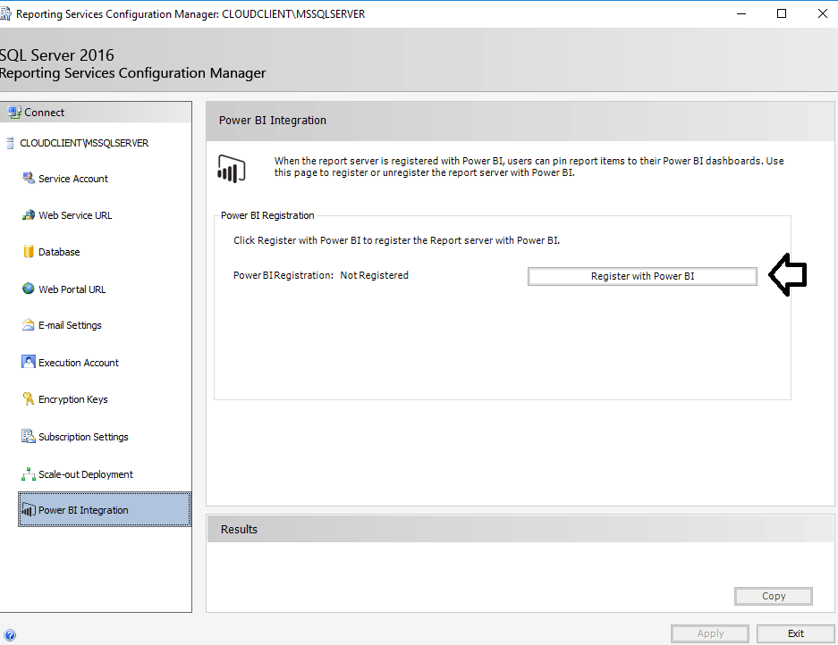
Integrating Power BI and SSRS

Slide 16
Summary
Integrating Power BI with SQL Server 2016
Implementing Tabular Databases with SSAS
Connecting Power BI to Analysis Services
Implementing Reporting Solutions with SSRS
Integrating Power BI and SQL Reporting Services

